Slide 1
CS152 Discussion Section 3

Slide 2
Agenda
Problem Set 1 review
Memory hierarchy

Slide 3
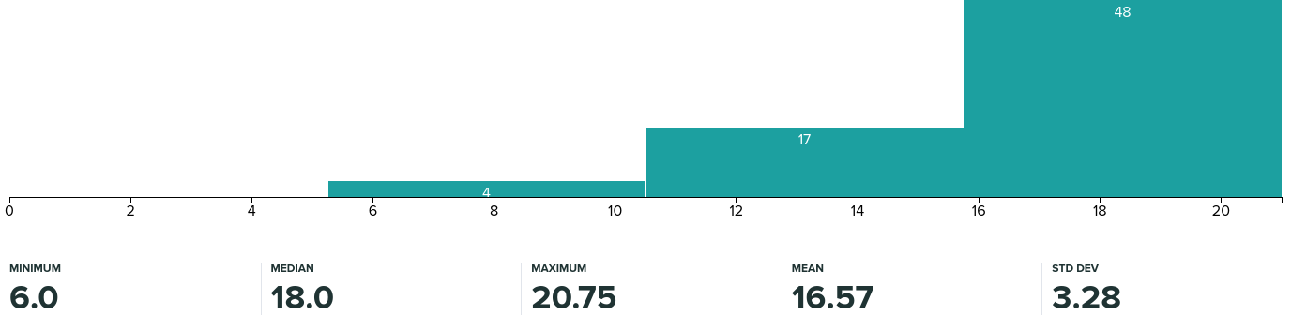
Administrivia
PS1 grades released
Regrades open until Feb 19th
Lab1 due Wed Feb 17 11:59 pm
PS2 released, due Wed Feb 24 11:59 pm
No class on Monday (Enjoy President’s Day)

Slide 4
Comparing ISAs
Common areas to address:
Instructions may involve memory accesses even when their mnemonics are not “load” or “store”
Implicit stack spills
AND instruction in accumulator ISA
Off-by-one errors
Loop body runs for 15 iterations, but loop condition is checked 16 times
“subi” is not a RISC-V instruction
Don’t forget to define location of labels in code if used

Slide 5
Micro-programming
Common areas to address:
Datapath details
Where do rs1/rs2/rd/imm come from?
How do we redirect the PC?
EnMem vs MemWr, EnReg vs RegWr
Code details
Pointers vs values: M[rs1] vs rs1
Optimization - not checked, but important
Tip: Split up your code into basic blocks, won’t be penalized for whitespace
Underflow/Overflow (A <= B) =/= (A - 1 < B)
Microcoded execution
Fetch routine is executed for all instructions
Difference between taken vs not-taken branch

Slide 6
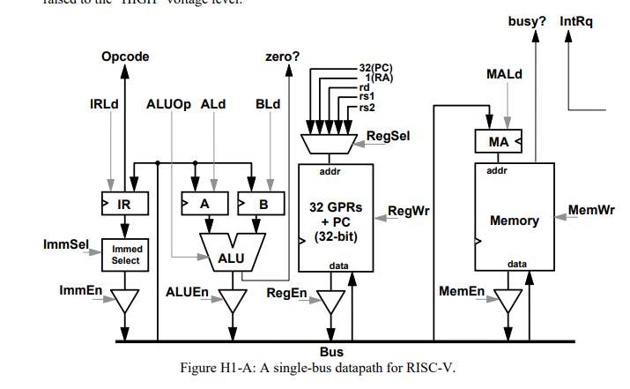

Slide 7
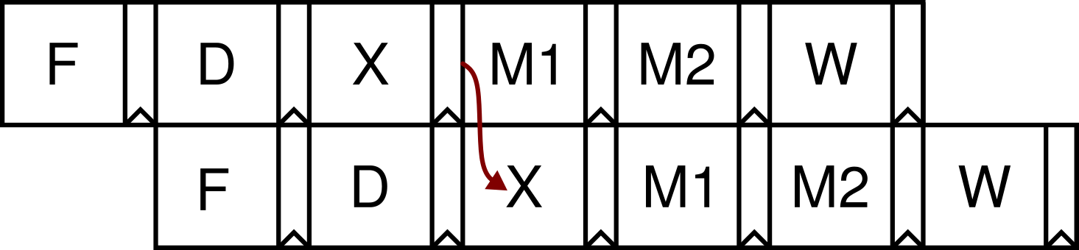
6-stage Pipeline
Use precise terminology for bypass paths - not just “EX→EX” or “ALU→ALU” (Where is the bypass source coming from? EX or M1?)
WAR is still not an issue - why?
Commit point is not in writeback stage
Some interlocks proposed in 3.D were correct but more pessimistic than necessary

Slide 8
CISC vs RISC
Common areas to address:
Compilers are better for RISC. Why?

Slide 9
Iron Law
Common areas to address:
What does adding a branch delay slot mean?
How does the pipeline change to support a CISC instruction?
How does instruction mix affect CPI?
What changes reduce critical path? Size of structures contributes.
How to deal with memory latency in a pipeline?
What are pros/cons of using both 16bit/32bit instructions together?
Advantage of microcoding?

Slide 10
Cache Organization
Consider a 1 KiB 4-way set-associative cache with 32-byte cache lines. The address is 12 bits wide. How are the address bits partitioned?
Tag:
Index:
Offset:

Slide 11
Replacement Policy
Random
Why is this not as bad as it sounds?
Least-Recently Used (LRU)
Pseudo Least-Recently Used (PLRU)
First-In First-Out (FIFO)
Not-Most-Recently Used (NMRU)
Plus many more possibilities...

Slide 12
Replacement Policies
Suppose we see the following stream of accesses where A, B, C, D, and E represent unique addresses from different lines that all map to the same set:
A, B, C, D, B, A, E
Assume the cache has four ways and all lines in the set are initially invalid. When address E is accessed, one of the cache lines must be evicted. For each replacement policy, which line gets evicted?
FIFO
NMRU
LRU
PLRU

Slide 13
FIFO
State: next line to replace
On replacement, increment state
Assume state starts at 0
Access | Way0 | Way1 | Way2 | Way3 | State after Access
A
B
C
D
B
A
E

Slide 14
NMRU
Almost same as FIFO
State: next line to replace
On replacement OR hit to line-to-be replaced, increment state
Assume state starts at 0
Access | Way0 | Way1 | Way2 | Way3 | State after Access
A
B
C
D
B
A
E

Slide 15
LRU
State: list of least recently accessed ways
Initial state: [3, 2, 1, 0]
On hit, move hit way to back of state list
To replace, pop from front of state list
Access | Way0 | Way1 | Way2 | Way3 | State after Access
A
B
C
D
B
A
E

Slide 16
Pseudo-LRU Binary Tree
(n - 1) bits of state per set for n-way cache
On hit or replacement, set all bits on root→leaf path to point to other half
On cache miss, bits indicate which way to replace
0
1
0
1
0
1
Way 0
Way 1
Way 2
Way 3

Slide 17
PLRU
Represent tree as 0(0)(0)
Initial state is 0(0)(0)
Access | Way0 | Way1 | Way2 | Way3 | State after Access
A
B
C
D
B
A
E
0
1
0
1
0
1
Way 0
Way 1
Way 2
Way 3

Slide 18
4-way Pseudo-LRU
 | Cache Tags (hex)
Address (hex) | Set 0 |  |  |  |  | Set 1 |  |  |  |  | Hit?
 | Way 0 | Way 1 | Way 2 | Way 3 | PLRU State | Way 0 | Way 1 | Way 2 | Way 3 | PLRU State
208 | 2 | inv | inv | inv | 110 | inv | inv | inv | inv | 000 | no
22C |  |  |  |  |  | 2 |  |  |  | 110 | no
41C |  |  | 4 |  | 011 |  |  |  |  |  | no
604
320
214
310
50C
404
time

Slide 19
Cache Optimizations
Increase / Decrease / No Change
Technique | Hit Time | Miss Penalty | Miss Rate | Hardware Complexity
Smaller, simpler caches
Multi-level caches
Smart replacement policy
Pipelined writes
Write buffer
Sub-blocks (sector cache)

Slide 20
Cache Optimizations
Increase / Decrease / No Change
Technique | Hit Time | Miss Penalty | Miss Rate | Hardware Complexity
Code optimization
Compiler prefetching
Hardware prefetching (stream buffer)
Victim cache

